Slide 1
Chapter 1
The Importance of MIS

Slide 2
“But Today, They’re Not Enough.”
Jennifer lacks skills Falcon Security needs:
Abstract reasoning skills
Systems thinking skills
Collaboration skills
Experimentation skills
Notes:
What's not good enough?
What should Jennifer have done differently?
To what extent are the four skills required in your education so far.
How do you feel about working with ambiguity?

Slide 3
What Do Employers Want?
Self starter, don’t wait to be told what to do
Team worker
Develop ideas and kick them around with others
Ask questions
Pull more than your own weight

Slide 4
Study Questions
Q1: Why is Introduction to MIS the most important class in the business school?
Q2: How will MIS affect me?
Q3: Why are MIS-related jobs in high demand?
Q4: What is MIS?
Q5: What is your role in IS security?
How does the knowledge in this chapter help you?
Notes:
Chapter Preview
It begins by discussing the key skills that students need and explains why this course is the best course for teaching those key skills. The discussion of how important this class will be to your career, is followed by discussions of fundamental concepts. The chapter wraps up with some practice on one of the key skills students need to learn.
• Optional: CE1: Collaboration Information Systems for Decision Making, Problem Solving, and Project Management

Slide 5
Q1: Why Is Introduction to MIS the Most Important Class in the Business School?
Technology fundamentally changing business
Information Age
Production, distribution, control of information primary driver of the economy
Digital Revolution
From mechanical and analog devices to digital devices
Notes:
What happens when those costs are essentially zero?

Slide 6
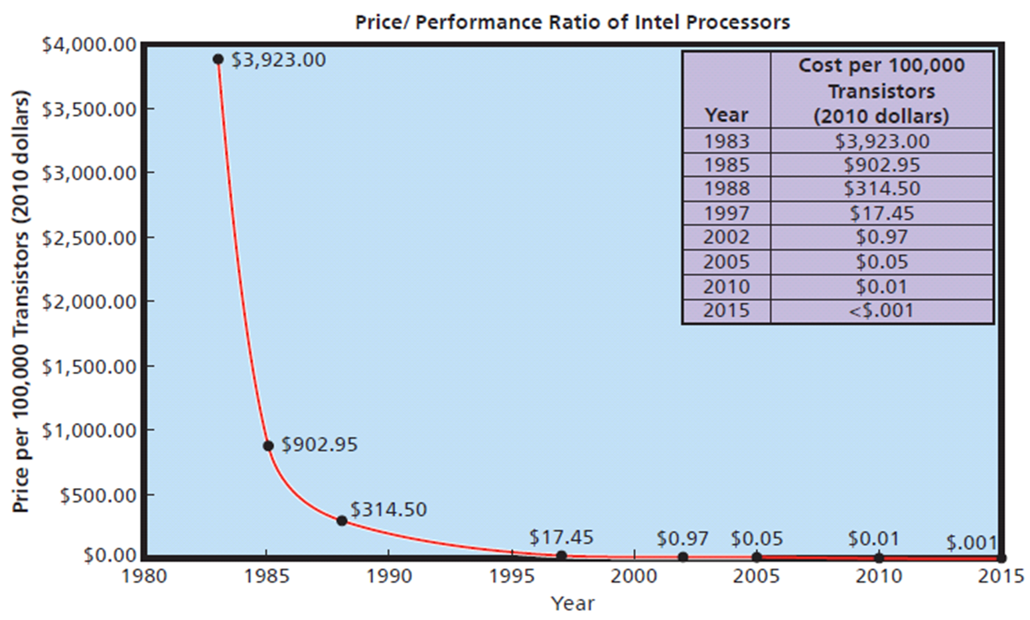
Evolving Capabilities: Computer Price/Performance Ratio Historical Trend
Moore’s Law
Notes:
Moore’s Law: “The number of transistors per square inch on an integrated chip doubles every 18 months.”
You needn’t care how fast of a computer your company can buy for $100.

Slide 7
Understanding the Forces Pushing the Evolution of New Digital Devices
Bell’s Law
New computers, platforms, programming environments, industries, networks, information systems roughly every 10 years
Establishing a new industries
Understand how businesses will be affected by digital evolution
What existing industries do, they how does it changes

Slide 8
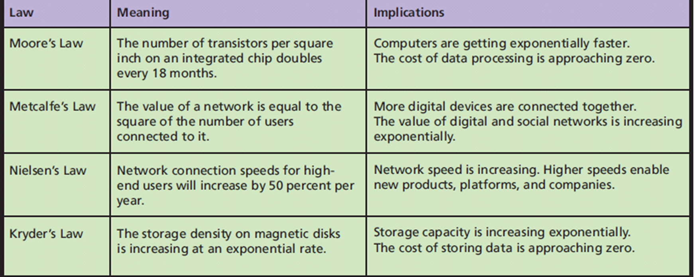
Fundamental Forces Changing Technology
Notes:
Metcalfe’s Law: Google, Amazon, eBay companies exist due to large numbers of users connected to the Internet.
Nielsen’s Law: Faster networks new companies, new products, new platforms. Connection speed test
Kryder’s Law: Smartphones, computers get smaller, more storage.

Slide 9
This Is the Most Important Class in the School of Business Because You Will Learn:
How technology fundamentally changes businesses
Why executives try to find ways to use new technology to create a sustainable competitive advantage
Learn to assess, evaluate, apply emerging information technology to business
This course will help you attain knowledge needed by future business professionals

Slide 10
Q2: How Will MIS Affect Me?
Technological change accelerating
Bell’s Law affect
Highly successful business could be bankrupt quickly because technology changed and it didn’t
Ex: Blockbuster
Notes:
Changes in technology will threaten your job security and provide opportunities, if you have the skills and desire to use them.

Slide 11
How Can I Attain Job Security?
Moore’s Law, Metcalfe’s Law, Kryder’s Law
Driving data processing, storage, communications costs to essentially zero
Any routine skill can, and will, be outsourced to lowest bidder
Notes:
Can today's non-routine skills become routine in a few years. Identify some non-routine job skills.

Slide 12
What Skills Will Be Marketable During Your Career?
Rapid technological change and increased international competition:
Requires skills and ability to adapt
Favours people with strong non-routine cognitive skills
Message: Develop strong non-routine cognitive skills

Slide 13
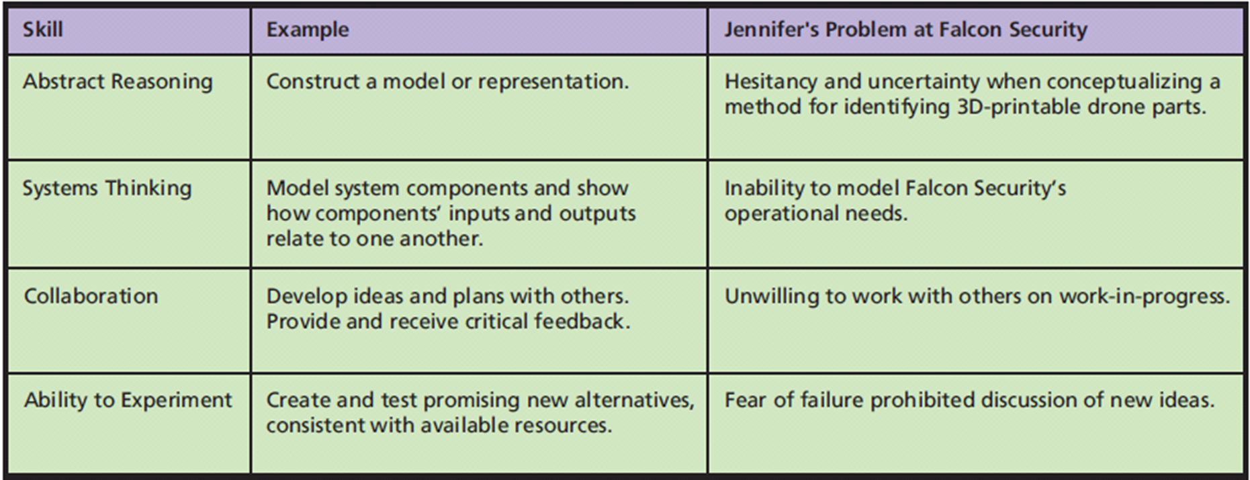
What Is a Marketable Skill?
Notes:
Rapid technological change and increased international competition place spotlight on workforce skills and preparation, particularly ability to adapt to changing technology and shifting demand.
How are abstract thinking and system thinking related?

Slide 14
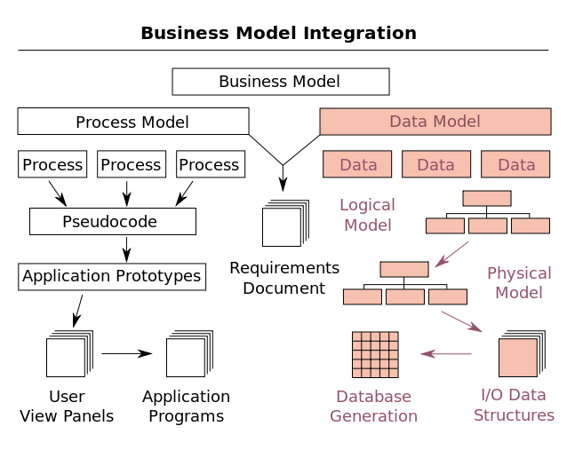
How Can Intro to MIS Help You Learn Non-Routine Skills?
Abstract Reason
Ability to make and manipulate models
Learn to use and construct abstract models
Ch. 1: Five components of an IS model
Ch. 5: How to create data models
Ch. 10: How to make process models
Notes:
Abstract thinking involves using models. One or more models in every course topic and book chapter.
The model example is from Wikipedia.org https://en.wikipedia.org/wiki/Data_model#/media/File:Data_modeling_context.svg.

Slide 15
How Can Intro to MIS Help You Learn Non-Routine Skills? (cont’d)
Systems Thinking
Ability to model system components, connect inputs, and outputs among components to reflect structure and dynamics
Ability to discuss, illustrate, critique systems; compare alternative systems; apply different systems to different situations
Notes:
These skills are essential for business professionals.
The arrows in the data model provide visual connects between components.

Slide 16
How Can Intro to MIS Help You Learn Non-Routine Skills? (cont’d)
Collaboration
People working together to achieve a common goal, result, or work product
CE1 and CE2 discuss collaboration skills and illustrate several collaboration information systems
Notes:
Every chapter of this book includes collaboration exercises that you may be assigned in class or as homework.

Slide 17
How Can Intro to MIS Help You Learn Non-Routine Skills? (cont’d)
Ability to Experiment
Make reasoned analysis of an opportunity; develop and evaluate possible solutions
“I’ve never done this before.”
“I don’t know how to do it.”
“But will it work?”
“Is it too weird for the market?”.
Fear of failure paralyzes many good people and ideas
Notes:
Use features and functions of Microsoft Excel, Access not used before. Collaborate using Microsoft SharePoint, Google Docs and Spreadsheets, or other collaboration tools.
Think about Falcon Security's 3D printing problem. What are risks? Should they proceed?

Slide 18
Q3: Why are MIS-Related Jobs In High Demand?
69% of college graduates need additional training or education
46% working in jobs not requiring their degree, underemployed
Better success for students with courses related to information systems
Tradable job
Not dependent on particular location likely outsourced overseas
Notes:
One in two recent college graduates either unemployed or underemployed, but, not in all job categories.
Will these trends change over the next 20 years?

Slide 19
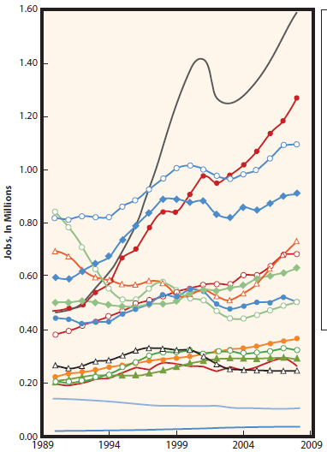
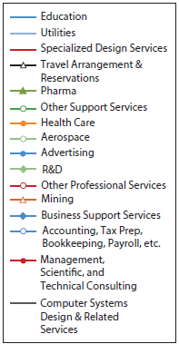
Job Growth over the Past Twenty Years
Notes:
This figure shows tradable jobs, it puts an end to the myth that all the good computer jobs have gone overseas.

Slide 20
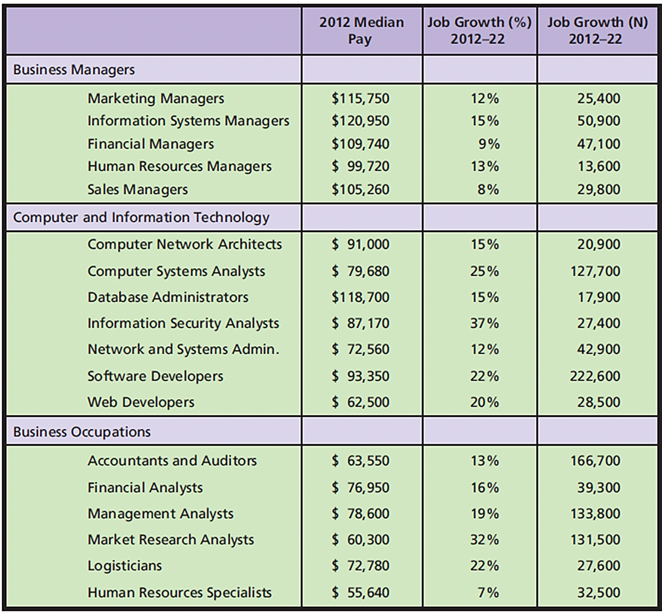
Job Growth by Sector by Year
Notes:
Figure 1-6 shows the U.S. Bureau of Labor Statistics recent job projections for business managers, computer and information technology, and other business occupations for the years 2012 to 2022. Growth rates of all information systems related jobs are above the 11 percent average for all occupations. Bureau of Labor Statistics, “Computer Systems Analysts,” Occupational Outlook Handbook, accessed April 16, 2015, www.bls.gov/ooh.

Slide 21
Bottom Line of MIS Course
Most important course in business school because:
Gives background you need to assess, evaluate, and apply emerging information systems technology to business
Gives you marketable skills by helping you learn abstraction, systems thinking, collaboration, and experimentation
Makes you aware of well-paying, high demand MIS-related jobs
Notes:
Ethics Guides help students to think about ethical dilemmas and clarify their values so they can respond appropriately to ethical challenges.

Slide 22
What Is Alibaba.com?
Started as e-commerce portal for buying and selling goods
Now includes a variety of financial, auction, and commerce services
Mission: Connect suppliers and buyers on global scale
Millions of products, dozens of product categories, thousands of messages exchanged daily between buyers and sellers
Growing Pains
Rapidly evolved from a “new idea”
Mired with suppliers selling counterfeit products
Vetting global suppliers and responding to fraud claims
Notes:
Take a few minutes to browse Alibaba.com and look at some examples of products that are for sale on the site. What are some of the logistical differences between buying something on Alibaba.com and buying something on Amazon.com?

Slide 23
What Can Alibaba.com Do for You?
Example of how managing information can be as profitable as selling a high-quality product
Demonstrates complexities associated with operating in a global economy
Illustrates what can be accomplished with a laptop, a good idea, a lot of hard work

Slide 24
Q4: What Is MIS?
Key elements
Management and use
Information systems
Strategies
Goal of MIS
Managing IS to achieve business strategies

Slide 25
What Is MIS (cont’d)
Management and use
Develop, maintain, adapt by:
Creating information system to meet your needs, take an active role in system’s development. Why?
Business professionals use cognitive skills to understand. business needs and requirements.

Slide 26
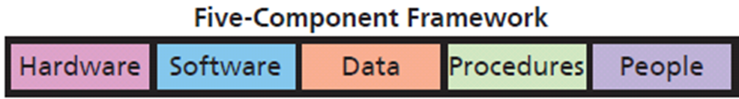
Components of an Information System?
Components interact to produce information
Notes:
Identify IS components of your university's online registration system.
This framework appears throughout the textbook.

Slide 27
Characteristics of the Five Components
Most Important Component -- YOU!
Cognitive skills determine quality of your thinking, ability to conceive information from data
Information is value you add to information systems
Only humans produce information
All components must work
Notes:
It’s only data until you or some other human take it into your mind and are informed by it.

Slide 28
Difference Between IT and IS
Information technology (IT)
Products
Methods
Inventions
Standards
IT drives development of new IS
IT components = Hardware + Software + Data
IS = IT + Procedures + People

Slide 29
Development and Use of Information Systems
Business professionals need to:
Take active role to ensure systems meet their needs
Understand how IS constructed
Consider users’ needs during development
Learn how to use
Ancillary (security, backups)

Slide 30
Achieving Strategies
Information systems exist to help people achieve business' strategies.
“What is the purpose of our Facebook page?”
“What is it going to do for us?”
“What is our policy for employees’ contributions?”
“What should we do about critical customer reviews?”
“Are the costs of maintaining the page sufficiently offset by the benefits?”
Notes:
Chapter 3 addresses the relationship between information systems and strategy in more depth.
Chapter 8 addresses social media and strategy specifically.

Slide 31
Q5: What is Your Role in is Security?
10+ characters
Does not contain your user name, real name, or company name
Does not contain a complete dictionary word in any language
Different from previous passwords used
Contains both upper- and lowercase letters, numbers, and special characters (such as ˜ ! @; #
$ % ^; &; * ( ) _ +; – =; { } | [ ] \ : “ ; ’ <; >;? , . /)
Notes:
One technique for creating memorable, strong passwords is to base them on the first letter of the words in a phrase.

Slide 32
Password Etiquette
Never write down your password
Never ask someone for their password
Never give your password to someone
“do-si-do” move—move away so another person can enter password privately
Common professional practice
Notes:
You are a protector of your employer's information system, customer, supplier, and your personal data.

Slide 33
How Does the Knowledge in this Chapter Help You?
Realize future belongs to those who creatively envision new applications of information systems and technology
Learn Reich’s four key skills
Learn IS components
Understand every business professional needs active role in new information systems development
Notes:
What impact will these have new products and services? Structure of organizations? Nature of work and education? Personal privacy? Personal relationships?

Slide 34
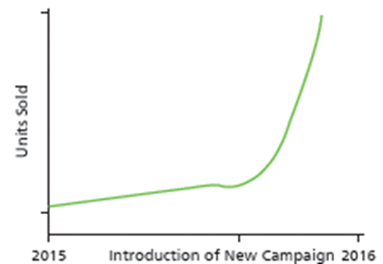
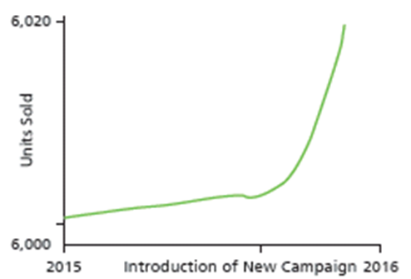
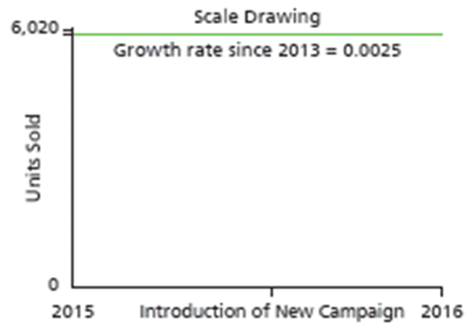
Ethics Guide: Ethics and Professional Responsibility
Which graph do you present?
Notes:
Use Kant’s categorical imperative, to explore ethical issues concerning deceptive data displays.
Practice applying the difference between data and information.
Note the graph on the left has no quantitative labels on the vertical axis; the vertical scale on the middle graph ranges only 20 units (20/6000=0.003%) which exaggerates insignificant variations; the scale of the last graph conceals variation in the data.

Slide 35
“What Is Right Behaviour?”
Immanuel Kant
Categorical imperative
One should behave only in a way that one would want the behavior to be a universal law.
Are you willing to publish your behavior to the world?
Notes:
How do you want other people behave?

Slide 36
Duty
Necessity to act in accordance with categorical imperative
Perfect duty - behavior that must always be met
Imperfect duty - a praiseworthy action, but not required
Giving to charity; developing your business skills and abilities
Notes:
Stealing cannot be a universal law. Lying is not consistent with the categorical imperative because if everyone lies, words are useless.

Slide 37
Imperfect Duty of Business Professionals
Imperfect duties
Cultivating your talent is a professional responsibility
Obtaining skills necessary to accomplish your job
Continuing to develop business skills and abilities throughout your careers

Slide 38
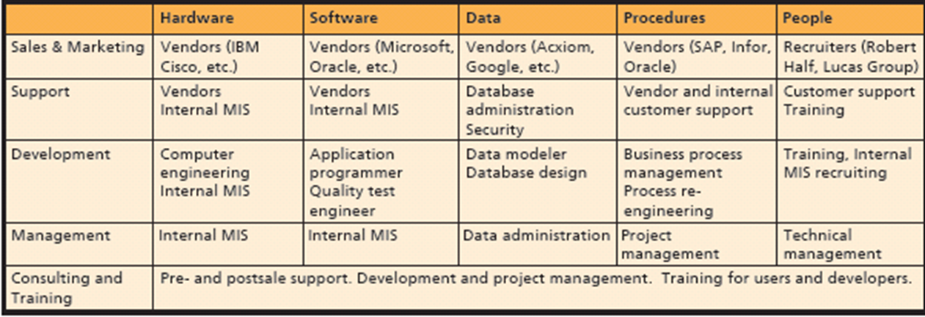
Guide: Five-Component Careers
Notes:
GOALS
Motivate students for study in this course and in others by reminding them of the need to prepare for jobs now. Employment will not necessarily be easy.
Broaden students’ perspectives about MIS careers. Many exciting jobs other than programmer or hardware specialist exist.
Make students aware that a lot of interesting jobs that require MIS skills are not necessarily “computer” jobs. Professional sales is one, for example.
Reinforce the five-component model and show students another way they can use it to guide their thinking.

Slide 39
Active Review
Q1: Why is Introduction to MIS the most important class in the business school?
Q2: How will MIS affect me?
Q3: Why are MIS-related jobs in high demand?
Q4: What is MIS?
Q5: What is your role in IS security?
How does the knowledge in this chapter help you?

Slide 40
Case Study 1: zulily
What is their business model?
Flash sales to mothers:
Children’s clothes, toys, women’s clothes, accessories, and décor items
IT provides entertaining shopping experience, name brand goods, unique and difficult-to-find off-brands, at substantial discounts
45% of sales over mobile devices
Curated sales
Notes:
Point of case: You should learn to assess, evaluate, and apply emerging information technology to business.
Curated sales are items specifically selected and grouped by its shopping experts that are targeted at women.

Slide 41
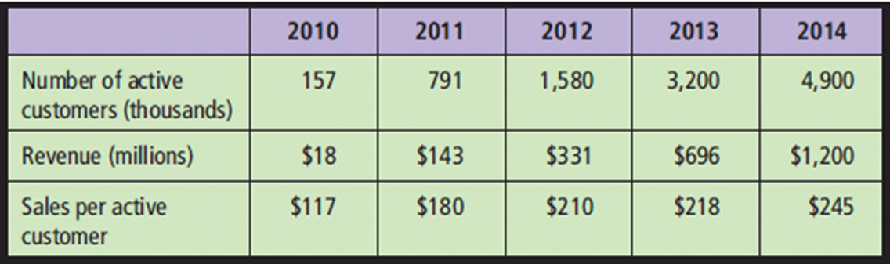
Case Study 1: zulily (cont'd)
Notes:
Effects of curated sales

Slide 42
How They Do It
Buyers identify goods to be sold, negotiate with vendors
Photographs sample items in-house, write ad copy
Group items for 3-day sales events
After event closes, zulily orders items from vendor, receives, packages, and ships to customers. (maintains no inventory)
Vulnerable to vendors errors and mistakes

Slide 43
Use of Technology
“Continual innovation through investment in technology is core to our business”
Internet, mobile technology compatibility
Developed a proprietary technology platform to handle enormous spikes in web processing demand
Extensive data collection and analytics capabilities

Slide 44
Growth-Management Problems
“To support continued growth, we must effectively integrate, develop and motivate a large number of new employees, while maintaining our corporate culture. In particular, we intend to continue to make substantial investments to expand our merchandising and technology personnel”
Need to hire mid-level managers
Finding and retaining merchandising and technology personnel difficult

Slide 45
Learning from zulily
Technology zulily uses is not ground breaking
Developed innovative application of information systems technology
Applied it to a business opportunity
Managerial skill to develop that idea
Notes:
Use questions at end of case

